Slide 1


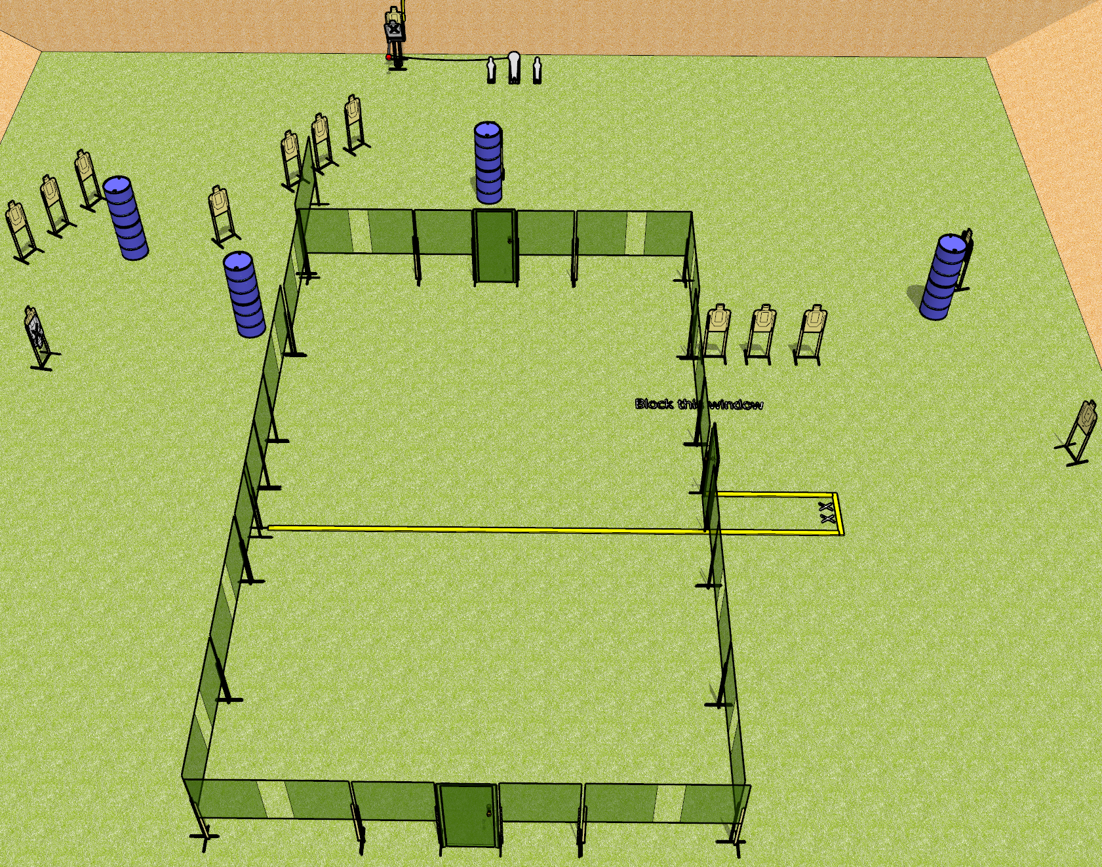
 | Dothan Gun Club – USPSA Match Nakatomi Plaza Course Designer : Drew Coleman
Round Count 33 rounds 15 USPSA targets 1 colt popper, 2 mini poppers
Equipment List 1 medium fault line 1 tuxedo, 1 50%

Slide 2
Nakatomi Plaza
Written Stage Briefing
Nakatomi Plaza is a 33 round, 165 point, Comstock course of fire. There are 15 terrorists (USPSA targets), 1 rocket launcher (colt popper), and 2 security cameras (mini poppers). The best 2 hits per terrorist will score, and steel must fall to score.
Hitting the rocket launcher will make a terrorist drop their hostage for a second (colt popper activates the max trap). He must be activated before being engaged, but he is visible at rest.
Handgun start position is feet on X’s, wrists above shoulders. Handgun is loaded and holstered.
PCC start position is feet on X’s, stock on belt. Carbine is loaded with safety on.
On start signal, shooter shouts a quote from Die Hard, and engages terrorists as they become available from within the shooting area.

